Slide 1
Module 10:
Big Data and Spark ML Applications
By Prof. Dr. Shanmugam Nandagopalan Ph. D
shanmugamnandagopalan@mfu.ac.th

Slide 2
Agenda
Introduction
2. Customer Segmentation
3. Real-Time Credit Card Fraud Detection
1. Log Analysis for Real-Time Monitoring
4. Sentiment Analysis in Video Conferencing

Slide 3
Introduction
The sheer volume of data generated on a daily basis has become astronomical, giving rise to the concept of Big Data.
This data explosion has revolutionized the way we interact with technology.
Example: Siri, Alexa, and Hi Google Now, etc.
Internet of Things (IoT) to gather information and provide intelligent responses to the business world.
This session discusses few applications of Big Data using Apache tools and Spark.
The world of Big Data and distributed data processing has opened up new horizons for various businesses.

Slide 4
Log Analysis for Real-Time Monitoring

Slide 5
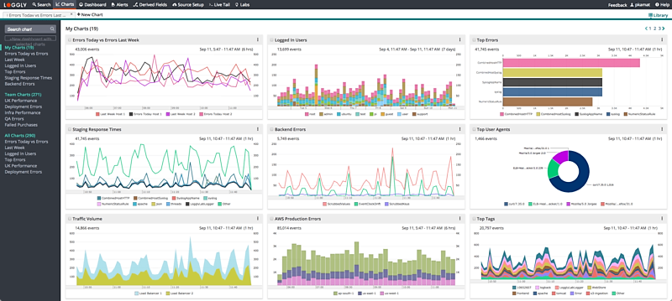
What is log Analysis?
Log analysis tools are software applications that collect, parse, and analyze log data from a variety of sources
Example: servers, network devices, and applications
They provide advanced features such as real-time monitoring, alerting, and visualization.
More recently, organizations have used log analysis for security and compliance purposes.
Logs can be used to track user activity and detect security incidents, such as attempted hacks or unauthorized access to sensitive data.

Slide 6
Features
Data collection: The ability to collect log data from multiple sources and store it in a central location, such as a log server or database.
Data parsing: The ability to parse log data and extract relevant information, such as timestamps, log levels, and log messages.
Visualization: The ability to visualize log data in a meaningful way, such as through graphs, charts, and tables.
Alerting: The ability to set up alerts that trigger when certain conditions are met, such as when a system error occurs, when a log is deleted, or when another kind of meaningful event is detected.
Real-time monitoring: The ability to monitor log data in near- or real-time and provide real-time alerts and notifications.

Slide 7
Benefits
Improved efficiency: automated process of collecting, parsing, and analyzing log data, making it more efficient and less time-consuming than doing it manually.
Advanced features: real-time monitoring, alerting, and visualization, which can help organizations quickly identify and resolve issues
Centralized log management: collect log data from multiple sources and store it in a central location, making it easier to manage and analyze.
Improved security and compliance: By analyzing log data, organizations can detect security incidents.
Better decision-making: gain valuable insights.

Slide 8
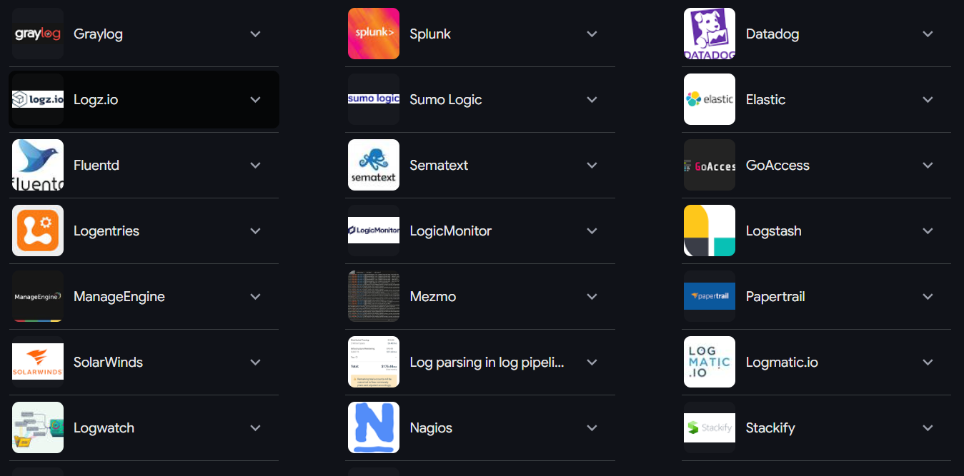
Tools
Graylog, Nagios, LOGalyze, Fluentd, Elastic Stack, Dynatrace, GoAccess

Slide 9
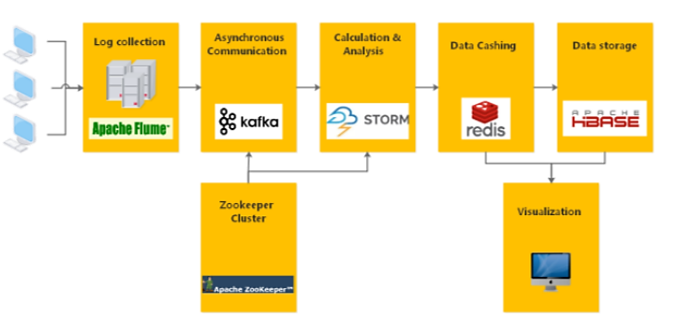
Architecture

Slide 10
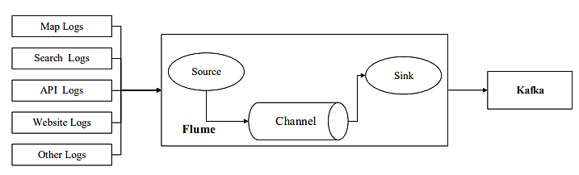
Technologies
Flume - is a distributed, reliable, and available service for efficiently collecting, aggregating, and moving large amounts of log data.
Kafka -is a distributed publish-subscribe messaging system, which can handle all the action flow data in a consumer-scale website.
Storm - is a free and open source distributed real-time computation system.
Distributed log collection architecture:

Slide 11
Customer Segmentation

Slide 12
What is Customer Segmentation?
dividing a company’s customer base into distinct groups, each characterized by shared traits or behaviors.
Key types of customer segmentation:
  Demographic Segmentation: age, gender, income level, and education.
  Geographic Segmentation: country or city but can drill down to regions, neighborhoods, or even climate type.
  Behavioral Segmentation: purchase behavior, spending habits, brand loyalty, and product usage.
  Others: lifestyle, values, attitudes, and interests

Slide 13
Big Data & Customer Segmentation
Data science is a field dedicated to extracting valuable insights from big data.
Data scientists utilize advanced analytical techniques to dissect this vast data source, revealing hidden patterns and insights.
These insights are then used as the building blocks of customer segmentation, allowing businesses to group their customers into distinct categories based on unique characteristics and preferences.
Targeted marketing strategies.

Slide 14
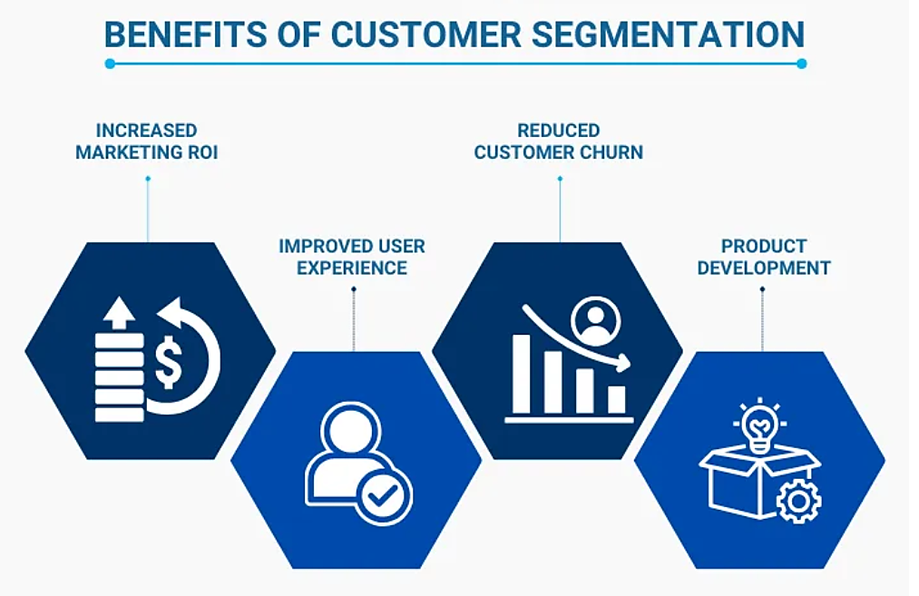

Slide 15
Why Targeted Marketing?
More personalized approaches, such as targeted Facebook and Google ads.
Example: a customer who consistently spends $20 every month. Offering them a reward for a purchase of that same amount wouldn’t be an effective incentive.
Because they are likely to make that purchase regardless.
Instead, a more strategic approach could be offering an enhanced reward for purchases over $25, encouraging an increase in their average spending.
Today, businesses have access to all the tools necessary for personalizing the entire customer journey across all channels —
  SMS, email, website interactions, mobile app engagement,

Slide 16
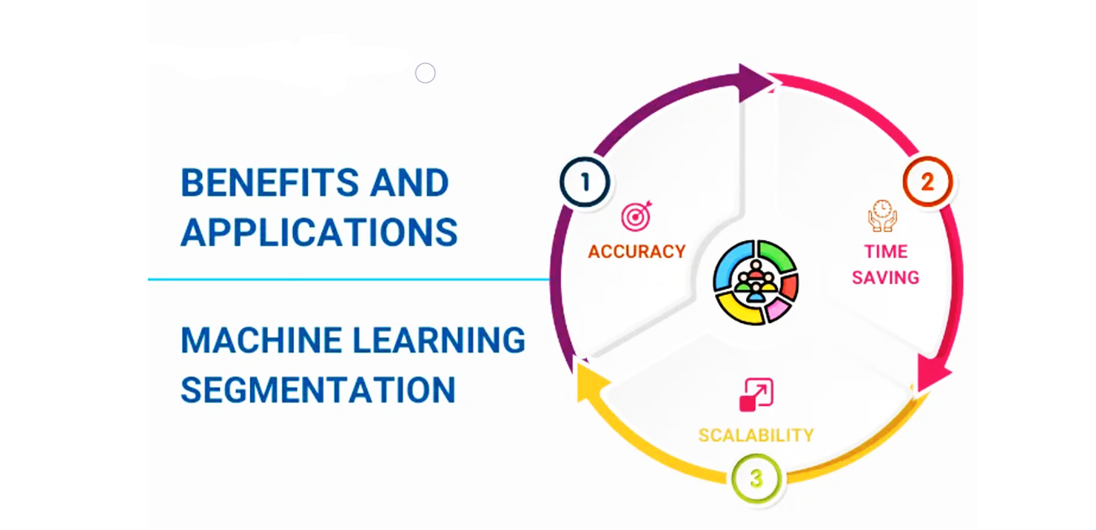

Slide 17
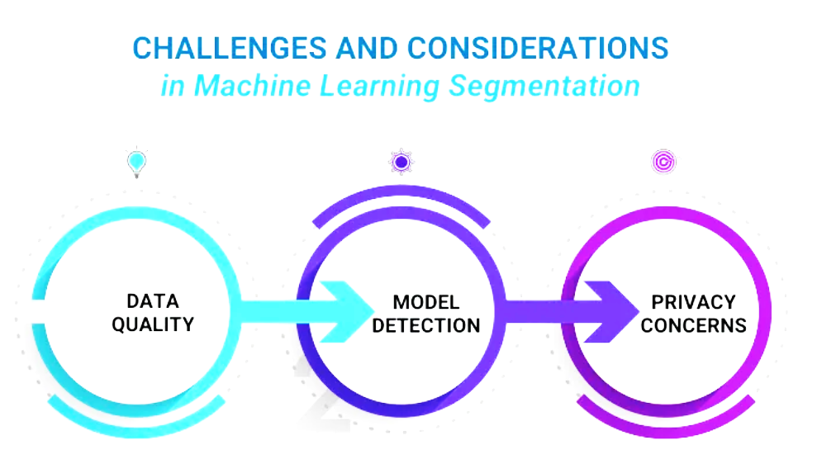

Slide 18
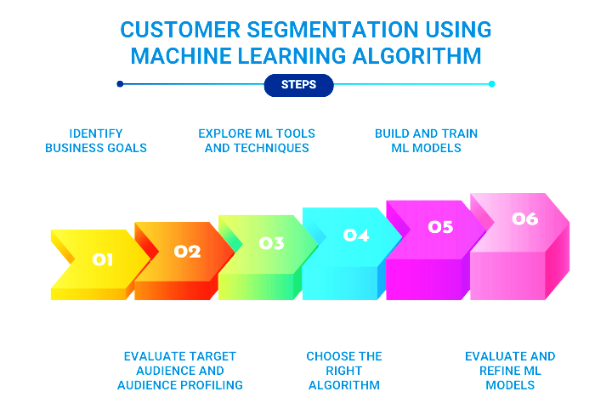

Slide 19
Algorithms
K-means clustering
Hierarchical Clustering
DBSCAN
Customer Segmentation Dataset
UCI - https://archive.ics.uci.edu/ml/datasets/online+retail
For Complete Code in Python, Click below:
https://www.kaggle.com/code/joshvads/customer-segmentation-for-retail

Slide 20
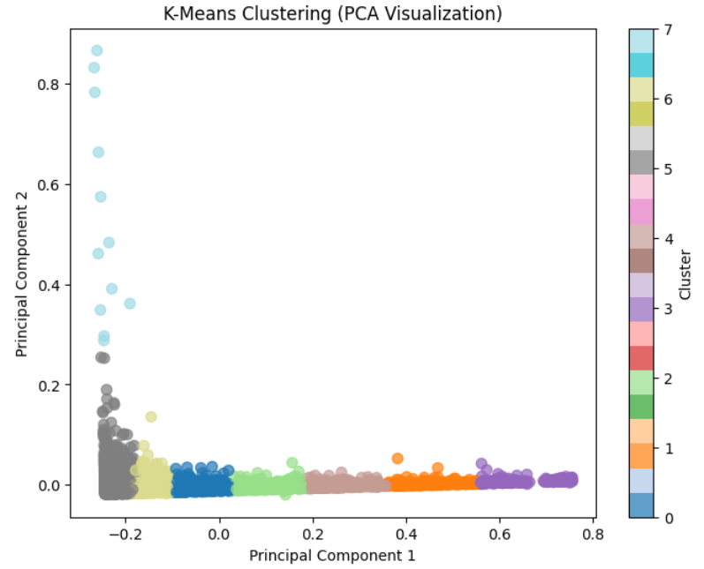
Output-1

Slide 21
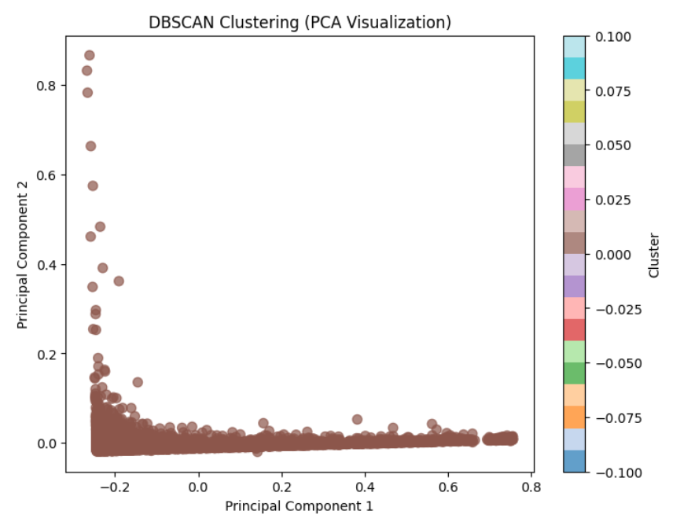
Output-2

Slide 22
Real-Time Credit Card Fraud Detection

Slide 23
3. Real-Time Credit Card Fraud Detection
This application that we will be building is a real-time fraud detection system.
The system will use Kafka to stream data from a variety of sources, such as credit card transactions and social media posts.
Spark will then be used to process the data and identify any fraudulent activity.

Slide 24
Method
Kafka - stream data from a variety of sources.
Spark - to process the data and identify any fraudulent activity.
The results of the analysis will be stored in a database.

Slide 25
Code
import spark
import kafka
import json
# Create a Spark session
spark = spark.sql.SparkSession.builder.appName("Fraud Detection").getOrCreate()
# Create a Kafka consumer
consumer = kafka.KafkaConsumer("fraud-detection", bootstrap_servers="localhost:9092")
# Process the data from Kafka
for message in consumer:
# Get the data from the message
data = json.loads(message.value)
# Check if the transaction is fraudulent
if is_fraudulent(data):
# Save the result to the database
db.insert_row(data)
# Close the consumer
consumer.close()

Slide 26
Check for fraudulent?
def is_fraudulent(transaction):
# Check if the transaction amount is too high
if transaction["amount"] > 10000:
return True
# Check if the transaction was made from a different country
if transaction["country"] != “TH":
return True
# Check if the credit card that has been flagged for fraud
if transaction["credit_card_number"] in flagged_credit_cards:
return True
# Return False if the transaction is not fraudulent
return False

Slide 27
Add fraudulent data to Database
def db.insert_row(transaction):
# Connect to the database
conn = pymysql.connect(host="localhost", user="root", password="password", database="fraud_detection")
# Create a cursor
cursor = conn.cursor()
# Insert the row into the database
cursor.execute
("INSERT INTO transactions (amount, country, credit_card_number, is_fraudulent) VALUES (%s, %s, %s, %s)", (transaction["amount"], transaction["country"], transaction["credit_card_number"], transaction["is_fraudulent"]))
# Commit the changes to the database
conn.commit()
# Close the cursor
cursor.close()
# Close the connection to the database
conn.close()

Slide 28
Sentiment Analysis in Video Conferencing

Slide 29
Sentiment Analysis in Hybrid Learning
Sentiment analysis in hybrid learning, using live facial expressions –
This case study is to understand student emotions and tailor the learning experience, potentially improving engagement and outcomes.
How it Works?
Facial Emotion Recognition (FER)
  This technology analyzes facial expressions from video data to identify emotional states.
Hybrid Learning
  This combines traditional methods (like lectures and readings) with technology-enhanced learning (e-learning platforms, online tools).
Real-time Analysis
  Systems can analyze facial expressions in real-time, allowing for immediate feedback and adjustments to the learning process.
Machine Learning Models
  Convolutional Neural Networks (CNNs) and Recurrent Neural Networks (RNNs) are commonly used to train models for emotion recognition.

Slide 30
Applications
Personalized Learning
Interactive Feedback
Identifying Mental Health Issues
Enhanced Engagement
Automated Grading

Slide 31
Problem Statement
The objective of this case study is to employ deep learning models to find out the facial expressions of participants.
It is assumed that this study is carried out in a video conference or e-learning platforms such as MS-Teams, Google Meet, Zoom, etc.
A complete software system is to be designed and developed to capture the emotions or sentiments of the participants in a real-time manner.
One of the main technologies used in this work is FER and Python for programming.

Slide 32
Method/Technique
MTCNN (Multi-Task Cascaded Convolutional Networks)
  This algorithm is a deep learning-based face detection and alignment method that uses a cascading series of convolutional neural networks (CNNs) to detect and localize faces in digital images or videos.
Three main stages
  proposal network (P-Net) - bounding boxes that may contain a face
  refinement network (R-Net) - refines the candidate bounding boxes
  output network (O-Net) - further refines
Applications
  security, entertainment, and marketing

Slide 33
FER (Facial Emotion Recognition)
Python library that focuses on detecting emotions from facial expressions.
Utilizing a pre-trained deep learning model, FER analyzes images and video to identify various emotions such as anger, disgust, fear, happiness, sadness, surprise, and neutrality.
It uses fer library of Python.
Faces are detected using OpenCV’s Haar Cascade classifier.
import cv2
from fer import FER
import face_recognition – finds all faces in an image

Slide 34
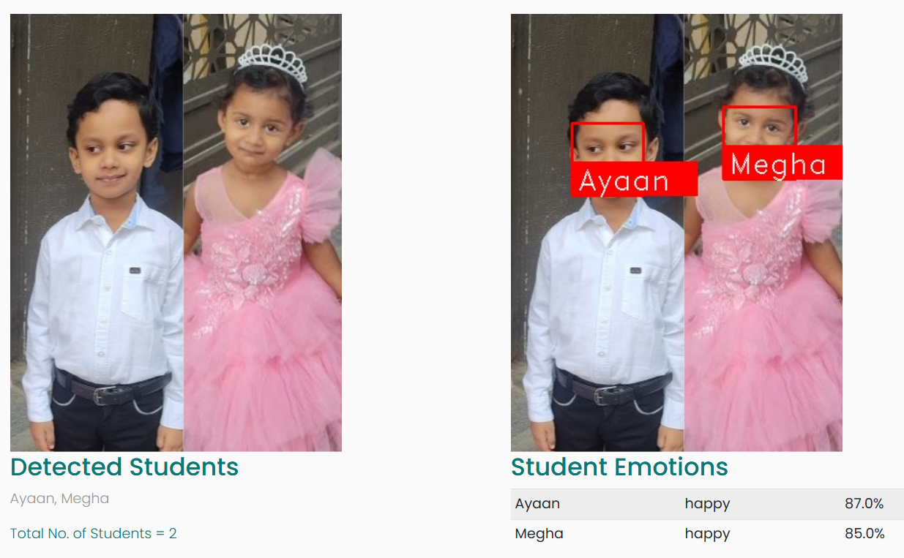
Sample Output-1
Known Faces

Slide 35
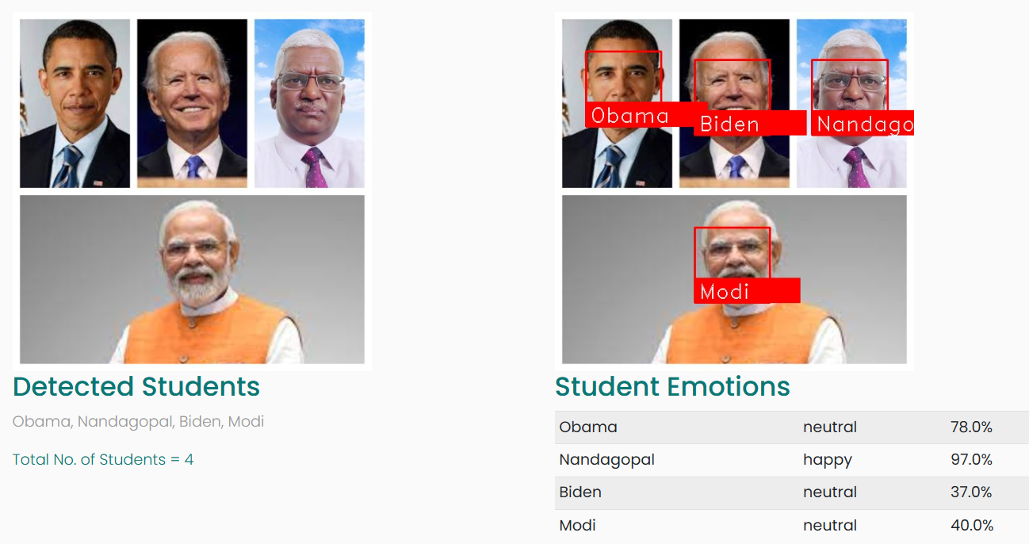
Sample Output-2
Known Faces

Slide 36
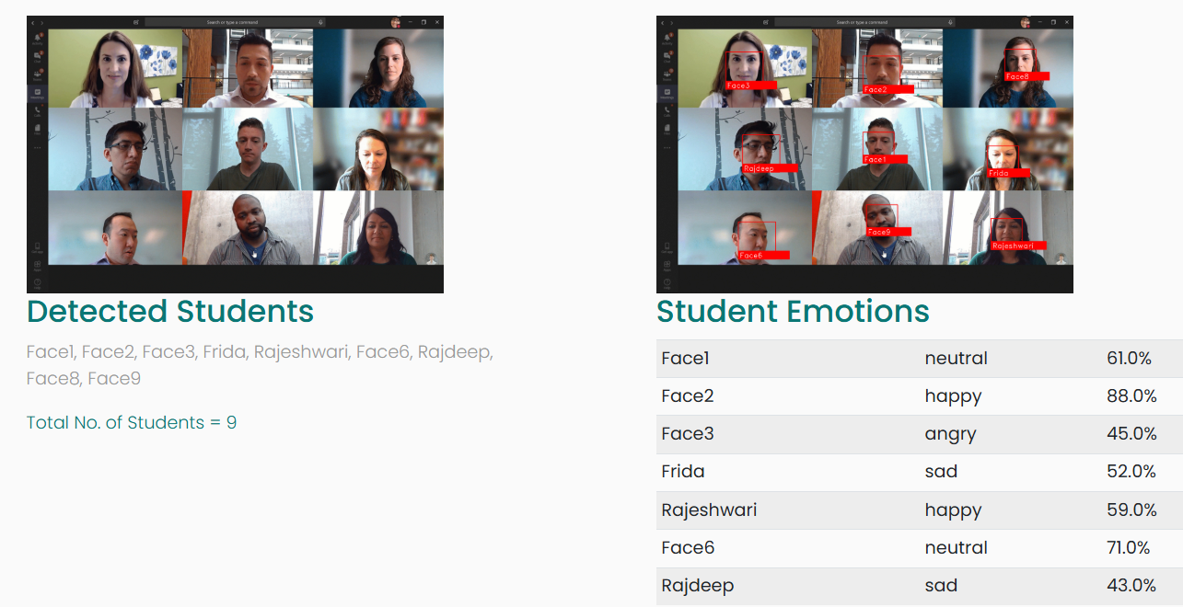
Sample Output-3
Unknown Faces

Slide 37
Thank You

